Slide 1
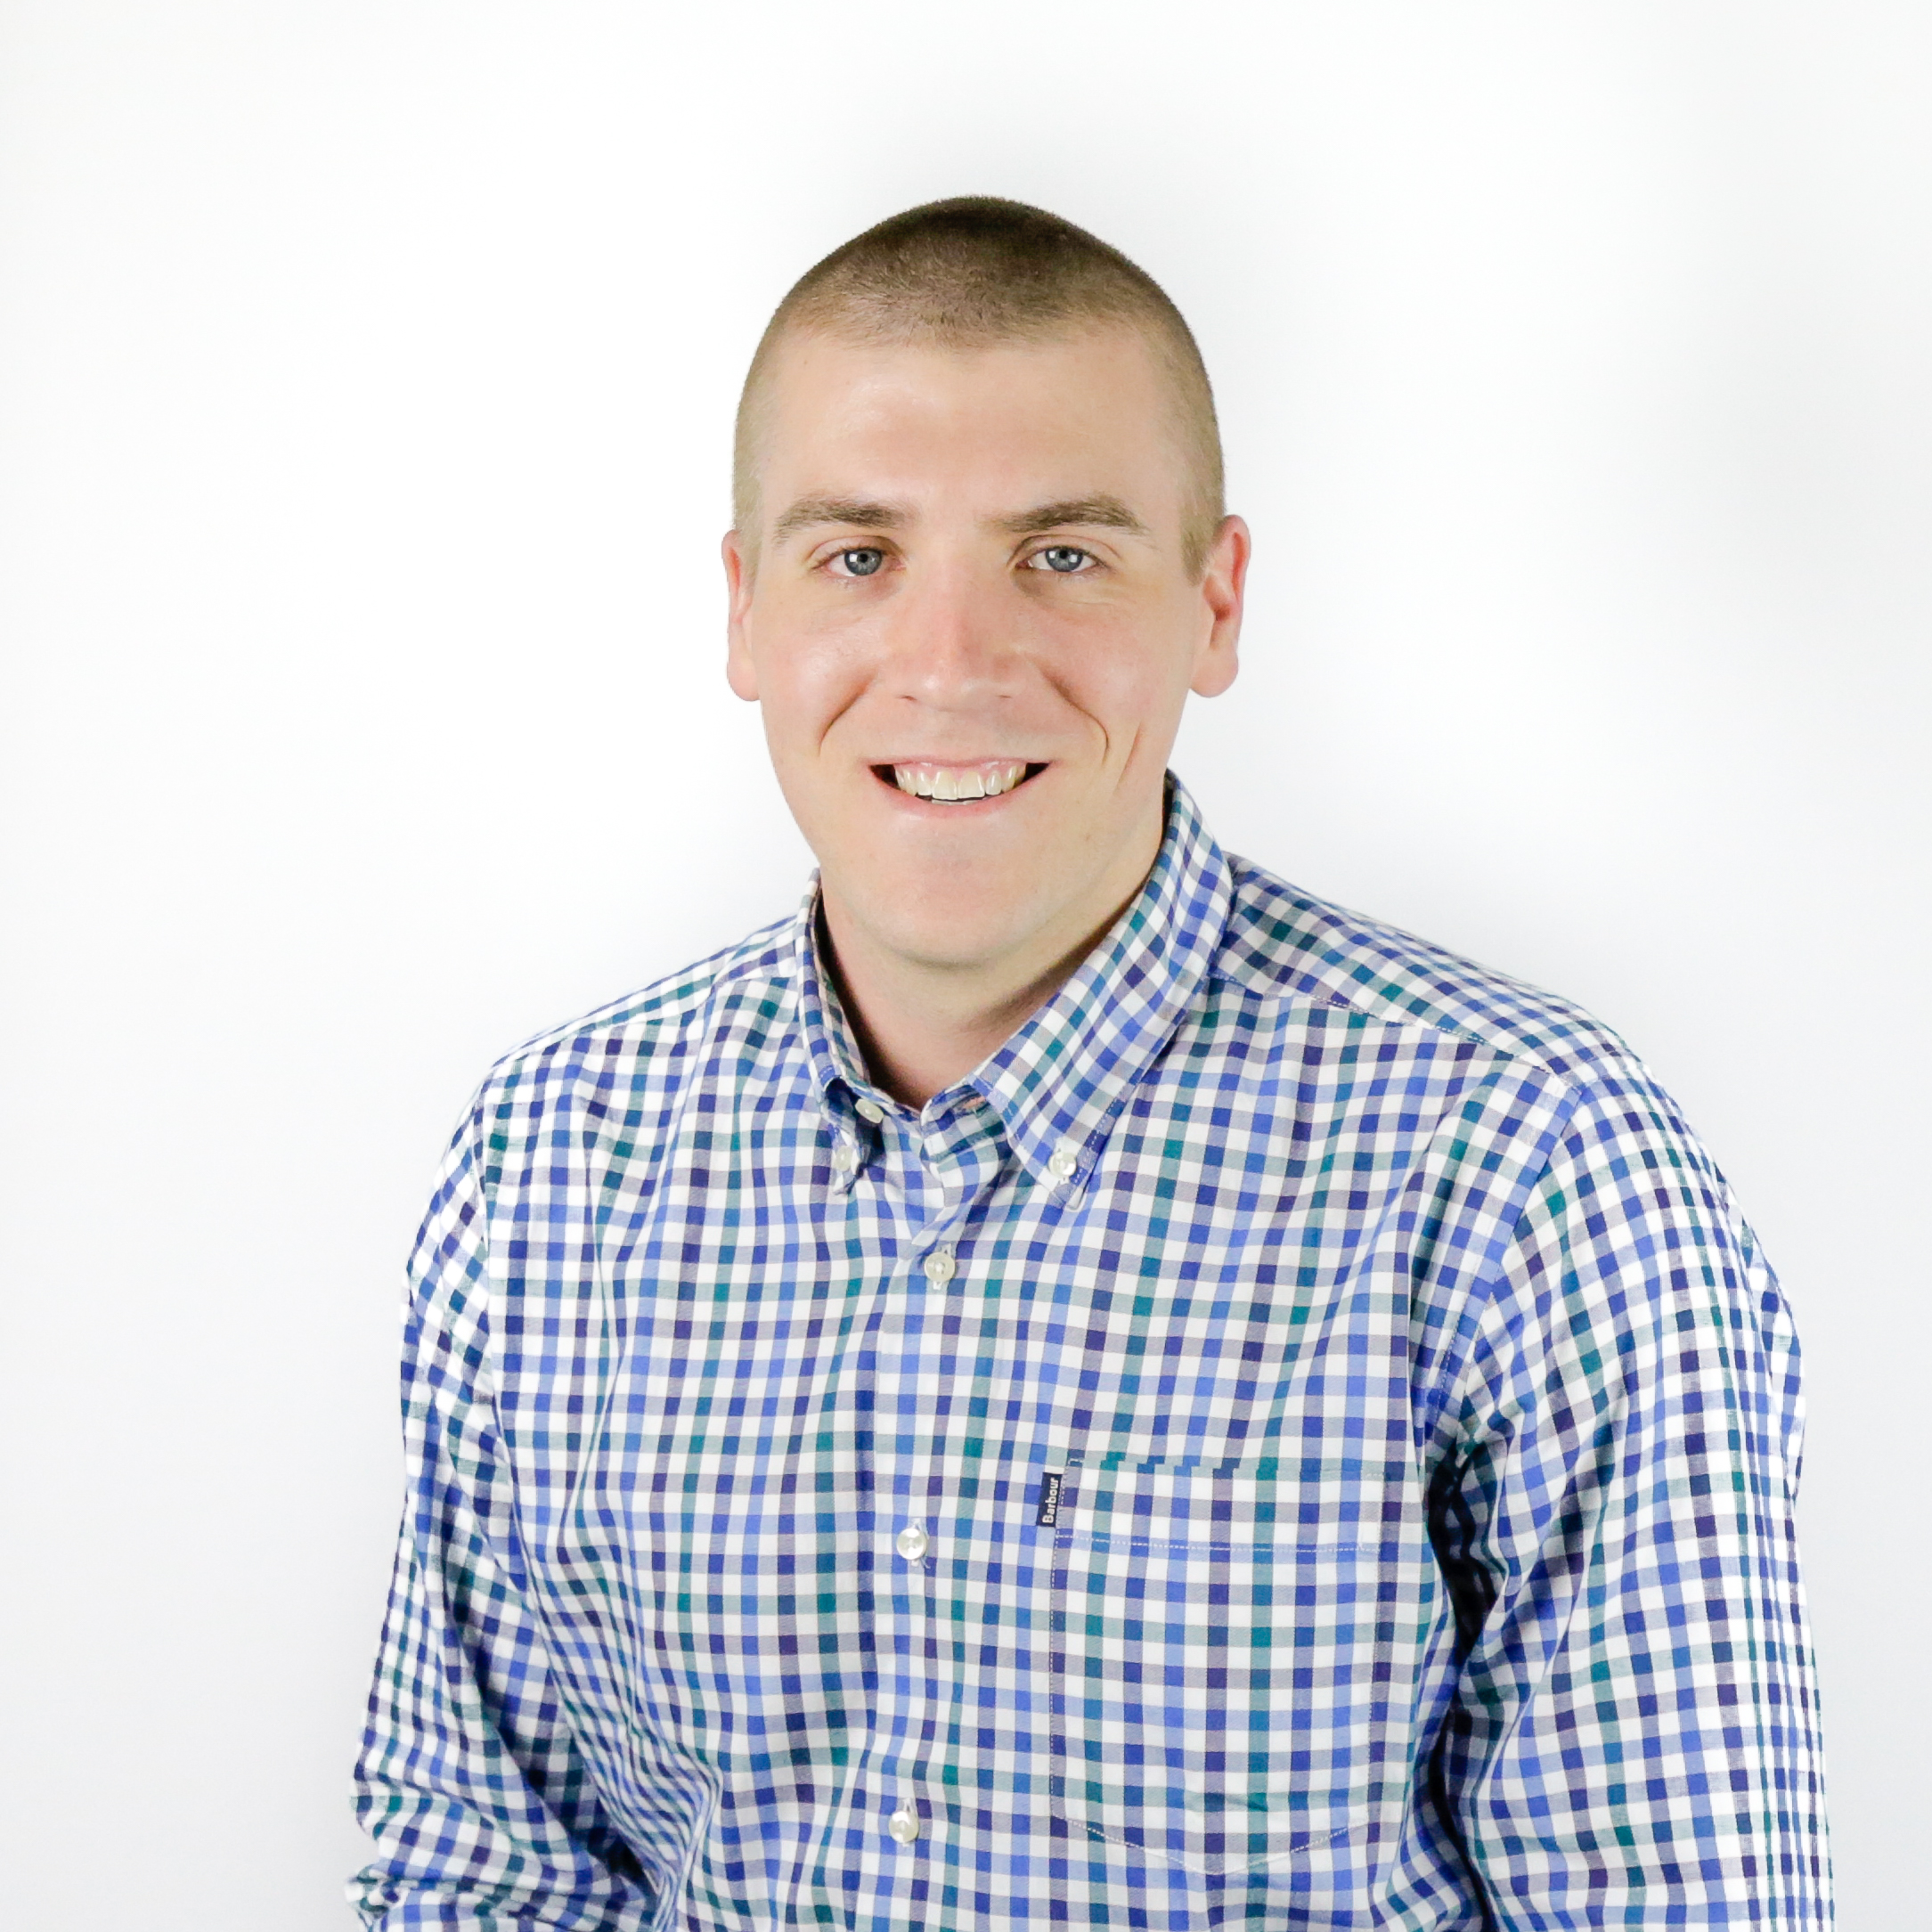
Ryan Cole Manager — Acceleration
Email
Ryan.cole@thebridge.com
Location
Syracuse, New York
Mobile
(703) 629-9342
Ryan joined The Bridge in August 2022 with over 6 years of experience in both domestic and international manufacturing and installation project management. He leverages his experience working with multiple trades in the entertainment & construction industries to thrive in collaborative environments.
EXPERIENCE
Industry Experience
Manufacturing | Construction | Theatre/Entertainment | Food Distribution | Cannabis
Processing Facility Buildout | Food Distribution & Construction
Managed relationships with various contractor/subcontractors, acting as the owner’s representative, to make decisions in the best interest of the company while maintaining clear lines of communication with CPNY leadership to keep informed of progress and to leverage input when needed.
Developed a Stakeholder Register. Project Timeliness Overview, Change & Open Issues Log, Risk Register, and Equipment Log – shared weekly with CPNY leadership – to ensure clarity, focus, and line of sight to challenges.
Executed a daily high-level summary of the day’s activities on site, any open concerns/issues, and what the forecasted upcoming work was on site to CPNY leadership.
Provided a Weekly Status Update which included the status of Open Changes & Issues, Risk Register, Project Timeline Overview, and outstanding questions requiring immediate answers.
Performance Hall Renovation | Manufacturing & Construction
Responsible for management of $10+ million contract for design & installation of theatrical rigging & acoustic equipment in premier performing arts facility in New York City.
Facilitate project team efforts and actions to Interpret project drawings and specifications to ensure proper machine and electrical design of custom equipment.
Lead communications between international vendor and project design team to assist in confirming functionality of design intent and customization of vendor’s standard product.
Coordinate installation manpower requirements with subcontractor to ensure project timeline is maintained.
BACKGROUND
Functional Skills
Project Management, Cost/Budget Analysis, Epicor 10 ERP System, Installation Coordination, Cross-Team Communication, Risk Identification & Mitigation, People Management
Qualifications
Certified Project Manager and SAFe 6 Agilist focused on working collaboratively with cross-functional teams towards successful project outcomes for clients.

Slide 2
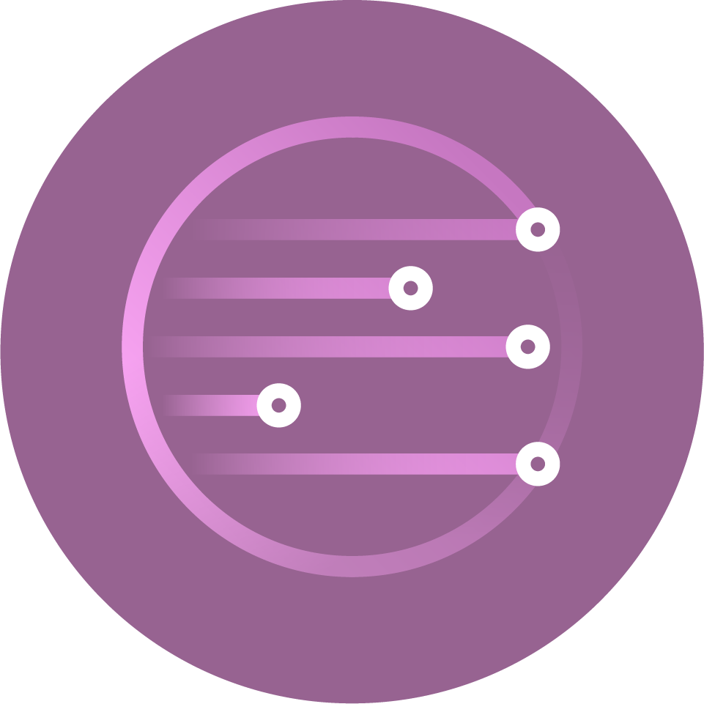
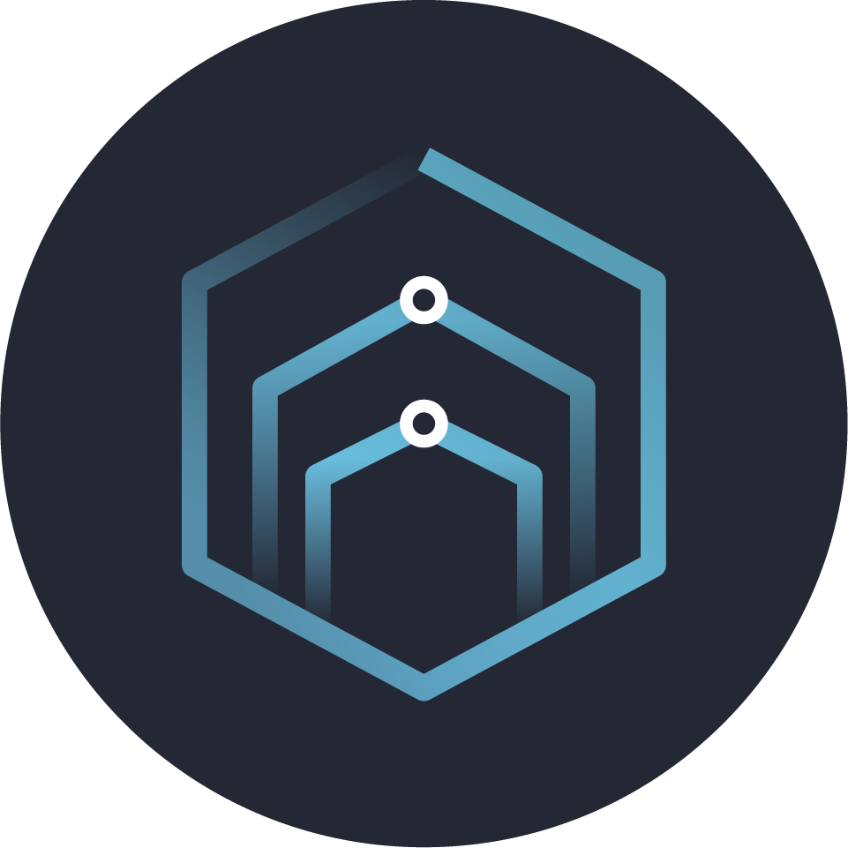
Email
Ryan.cole@thebridge.com
Location
Syracuse, New York
Mobile
(703) 629-9342
Ryan joined The Bridge in August 2022 with over 6 years of experience in both domestic and international manufacturing and installation project management. He leverages his experience working with multiple trades in the entertainment & construction industries to thrive in collaborative environments.
Ryan Cole Manager
Acceleration

Slide 3
Ryan Cole Manager — Acceleration
Email
Ryan.cole@thebridge.com
Mobile
(703) 639-9342
Location
Syracuse, New York
BACKGROUND
EXPERIENCE
Functional Skills
Project Management, Cost/Budget Analysis, Epicor 10 ERP System, Installation Coordination, Cross-Team Communication, Risk Identification & Mitigation, People Management
Qualifications
Certified Project Manager and SAFe 6 Agilist focused on working collaboratively with cross-functional teams towards successful project outcomes for clients.
Industry Experience
Manufacturing | Construction | Theatre/Entertainment | Food Distribution | Cannabis
Processing Facility Buildout | Food Distribution & Construction
Managed relationships with various contractor/subcontractors, acting as the owner’s representative, to make decisions in the best interest of the company while maintaining clear lines of communication with CPNY leadership to keep informed of progress and to leverage input when needed.
Developed a Stakeholder Register. Project Timeliness Overview, Change & Open Issues Log, Risk Register, and Equipment Log – shared weekly with CPNY leadership – to ensure clarity, focus, and line of sight to challenges.
Executed a daily high-level summary of the day’s activities on site, any open concerns/issues, and what the forecasted upcoming work was on site to CPNY leadership.
Provided a Weekly Status Update which included the status of Open Changes & Issues, Risk Register, Project Timeline Overview, and outstanding questions requiring immediate answers.
Performance Hall Renovation | Manufacturing & Construction
Responsible for management of $10+ million contract for design & installation of theatrical rigging & acoustic equipment in premier performing arts facility in New York City.
Facilitate project team efforts and actions to Interpret project drawings and specifications to ensure proper machine and electrical design of custom equipment.
Lead communications between international vendor and project design team to assist in confirming functionality of design intent and customization of vendor’s standard product.
Coordinate installation manpower requirements with subcontractor to ensure project timeline is maintained.

